Slide 1
Web3 Development for Beginners
By Ralph Kuepper

Slide 2
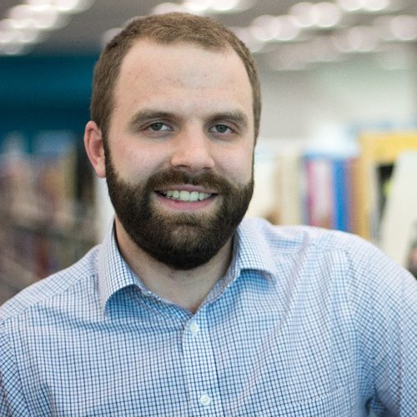
About Ralph Kuepper
Developer since 8 years old
Decades of software development
Worked on projects for companies like Adidas, KIA, Goldwell and others
Web3 since 2021
Fullstack and allrounder
NFTs and Tokens for 20k+ people
Teaching Blockchain topics
Speaker and Author
Married, 3 little dragons & a cat

Slide 3
About this course
No prior programming experience needed
General introduction to DeFi, Blockchain and Smart Contracts
Go through it as fast or as slow as you like
Objectives:
Understand the fundamentals of blockchain and web3
Understand how to read and write smart contracts using Solidity
Explain and develop the connection between frontend and blockchain
Deploy, use and extend smart contracts

Slide 4
What the course will look like
Introduction
Blockchain Fundamentals
Programming Fundamentals
Blockchain Economics
Blockchain Development
Where to go from here

Slide 5
Let’s dive in
Enjoy and let’s get working!

